Slide 1

CS 533 INTRO TO DATA SCIENCE
Michael Ekstrand

Slide 2
LOGISTIC REGRESSION

Slide 3

Learning Outcomes
Compute a logistic regression to predict a binary value
Understand generalizing linear regression
Photo by Vishnu Prasad on Unsplash

Slide 4
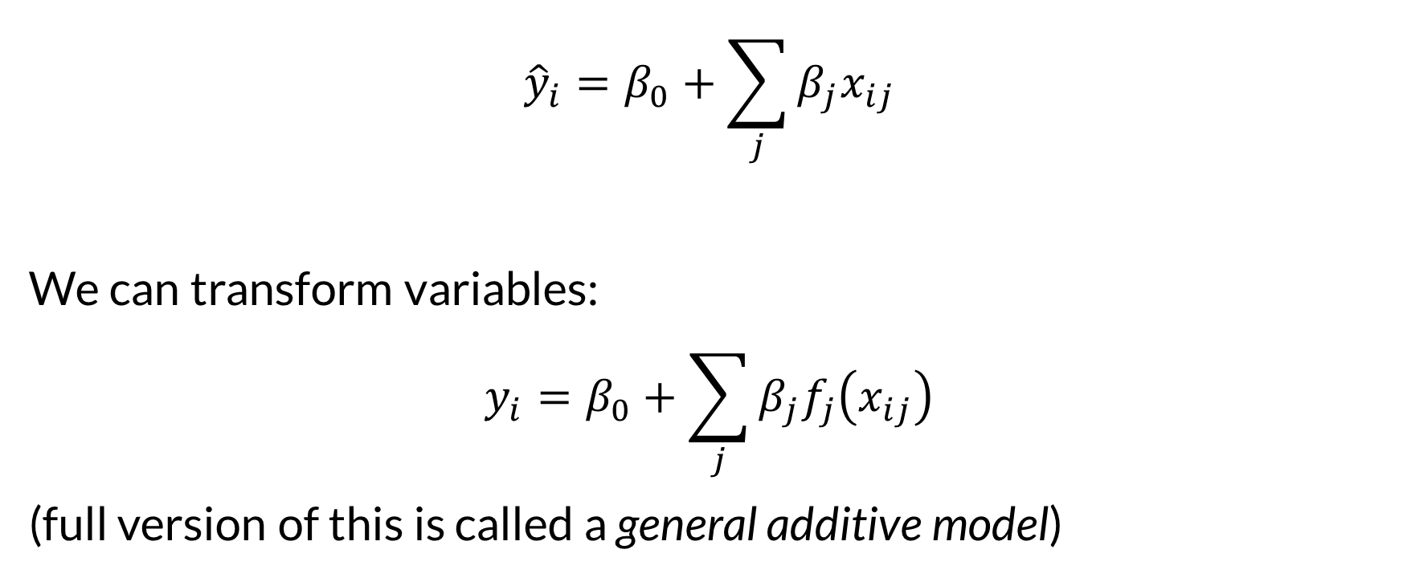

Linear Regression
$${\hat{y}}_{i}=β_{0}+\sum_{j}{β_{j}x_{ij}}$$
We can transform variables:
$$y_{i}=β_{0}+\sum_{j}{β_{j}f_{j}\left(x_{ij}\right)}$$
(full version of this is called a general additive model)

Slide 5
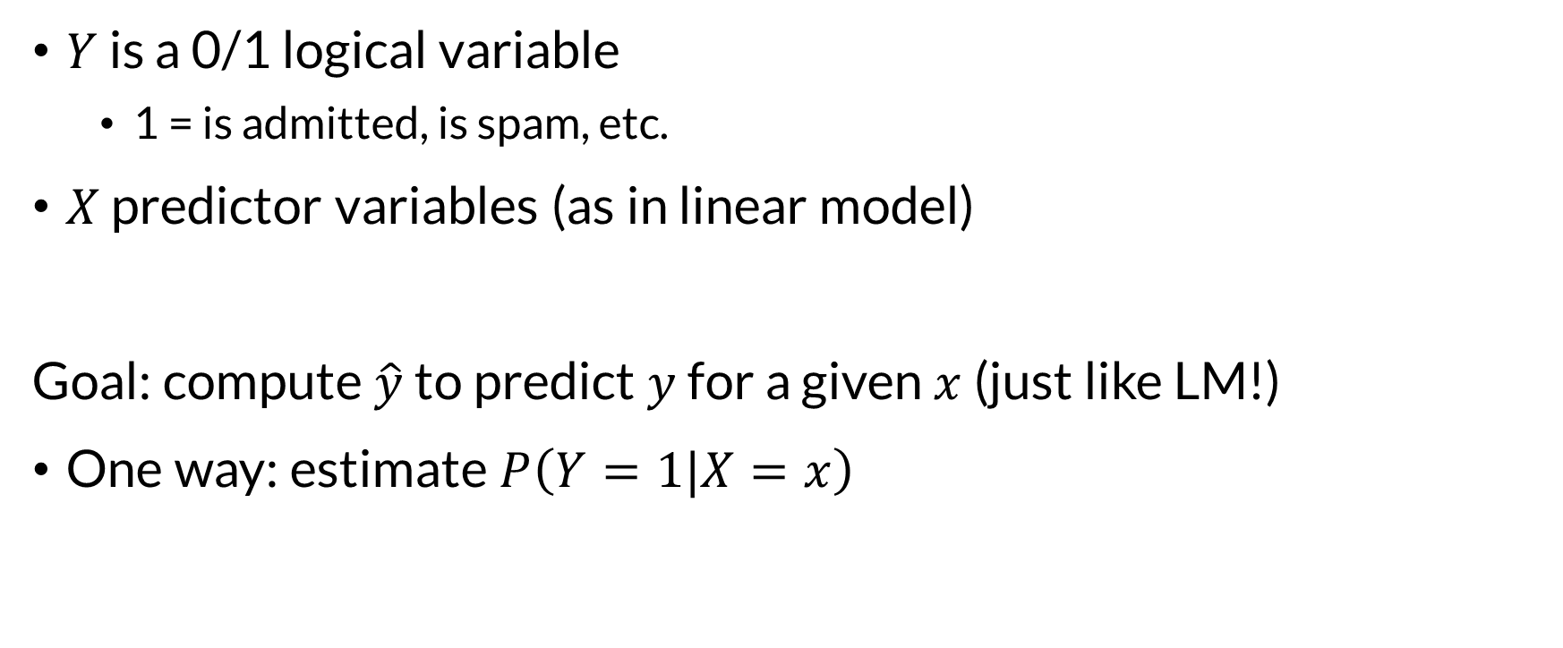
Classification Setup
$Y$ is a 0/1 logical variable
1 = is admitted, is spam, etc.
$X$ predictor variables (as in linear model)
Goal: compute $\hat{y}$ to predict $y$ for a given $x$ (just like LM!)
One way: estimate $P\left(Y=1|X=x\right)$

Slide 6
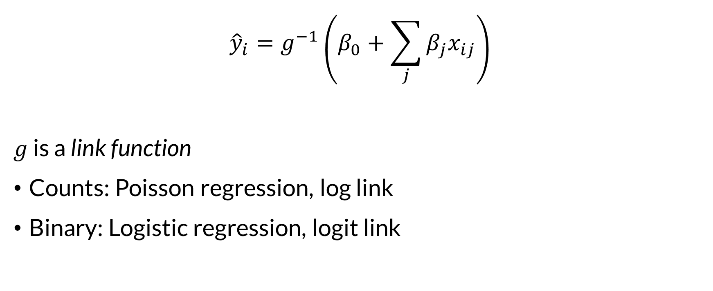
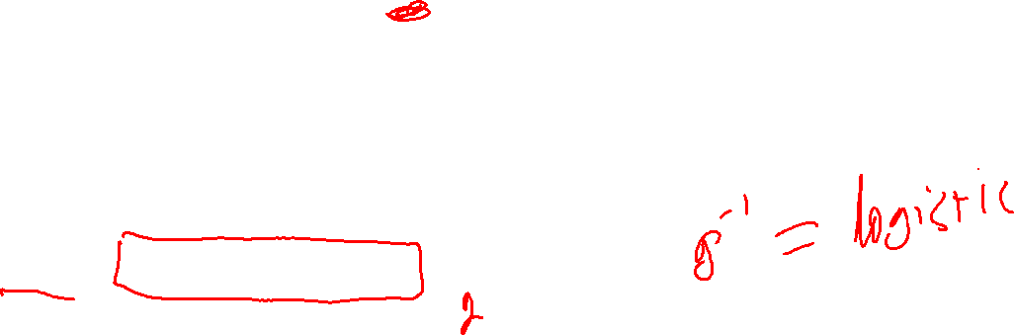
General Linear Models (GLMs)
$${\hat{y}}_{i}=g^{−1}\left(β_{0}+\sum_{j}{β_{j}x_{ij}}\right)$$
$g$ is a link function
Counts: Poisson regression, log link
Binary: Logistic regression, logit link

Slide 7


Logistic Regression
$$P\left(Y | x\right)=\hat{y}=logistic \left(β_{0}+\sum_{j}{β_{j}x_{j}}\right)$$
$y$ — admitted to grad school
$x_{1}$ — GRE
$x_{2}$ — GPA
$x_{3}$ — school rank

Slide 8
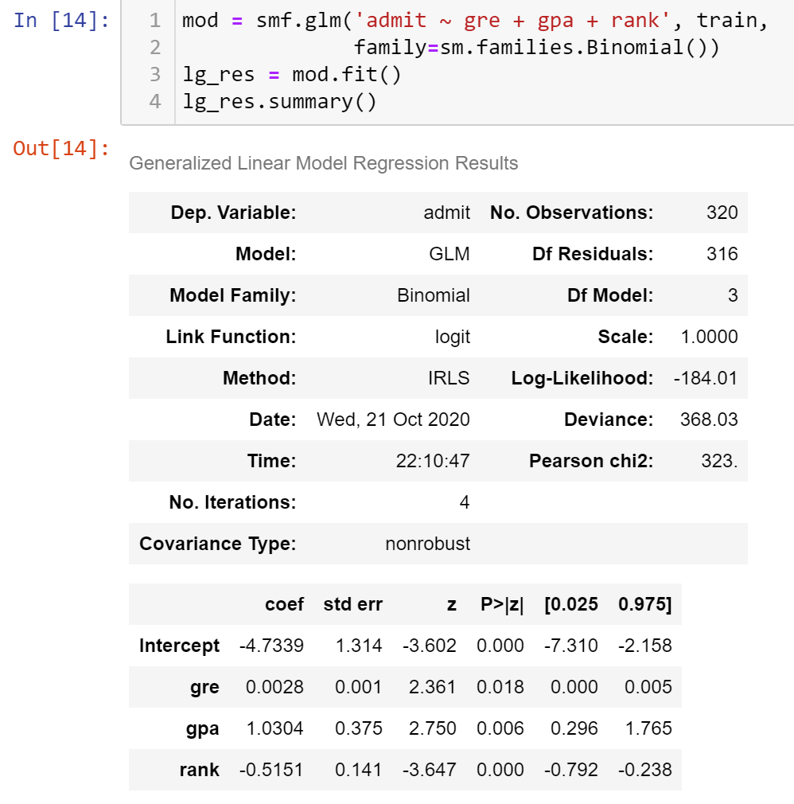

Training a GLM
Generalized linear model
Binomial family (logit link)
p-values test significance

Slide 9

Predicting with GLM
scores = lg_res.predict(test)
Results in predicted scores (estimated probabilities)
Convert to binary class w/ threshold:
decisions = preds > 0.5

Slide 10

Terms
Outcome — the true outcome of the data we seek to predict
Called ground truth
Score — our prediction score (logistic: estimated probability)
Decision — our binary decision
Usually done by thresholding score
Some models & software directly output predictions

Slide 11

Wrapping Up
General linear models allow linear predictions of other quantities.
Logistic regression lets us use linear models for binary classification.
Photo by Michèle Eckert on Unsplash

